Slide 1
Graduate Projects Meeting
May 1, 2026
Agenda
Course Requirements and Procedures
Proposal Requirements
How to add the course
Exploring the available Projects

Slide 2
Course Requirements and Procedures
Prerequisites for ME 295 A and ME 299 Course
Completed at lease nine-units in the program
Not Conditionally classified
Approved Candidacy form (or expected to be approved before submission of the project proposal)
Not on probation

Slide 3
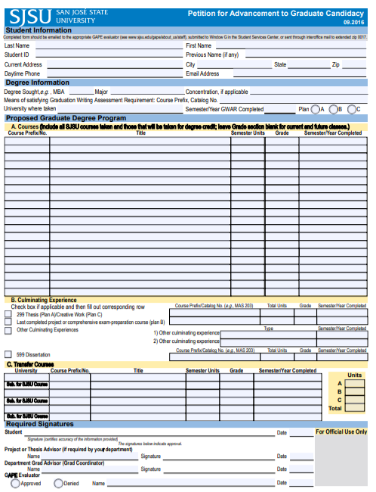
Project Proposal Requirements
1. Have an approved
Candidacy Form
Form is available on
the ME website

Slide 4
Project Proposal Requirements
Candidacy Form
https://www.sjsu.edu/me/docs/forms_gape-candidacy.pdf
Step-by-step Instructions for Filling out the Form
https://www.sjsu.edu/me/docs/msme_currentstudents-candidacy_form_instructions_02_05_19.pdf

Slide 5
The Proposal
2. A completed proposal should include:
A. The Project Cover Page
B. Approved committee evaluation
C. Approved Candidacy Form
D. A comprehensive and detailed proposal of the project
NOTE: Submit all the four items in the listed order and as one package
See the ME website for details:
https://www.sjsu.edu/me/graduate/current-msme/advising/project-and-thesis/project-proposal.php

Slide 6
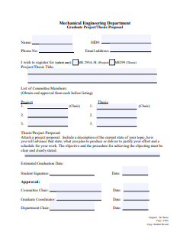
A. Project Cover Page

Slide 7
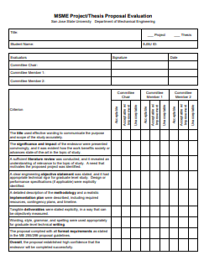
B. Committee Evaluation Form

Slide 8

3. Have the Proposal Ready
A proposal is considered complete when Signed by:
Your committee Chair
The Graduate Advisor
The department Chair

Slide 9
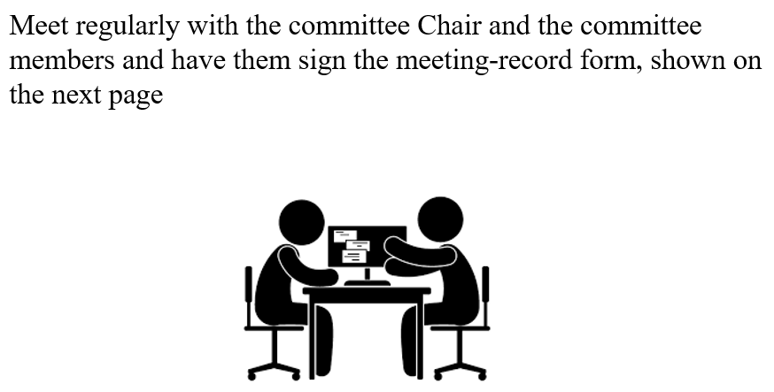
4. Post-Proposal Requirements

Slide 10
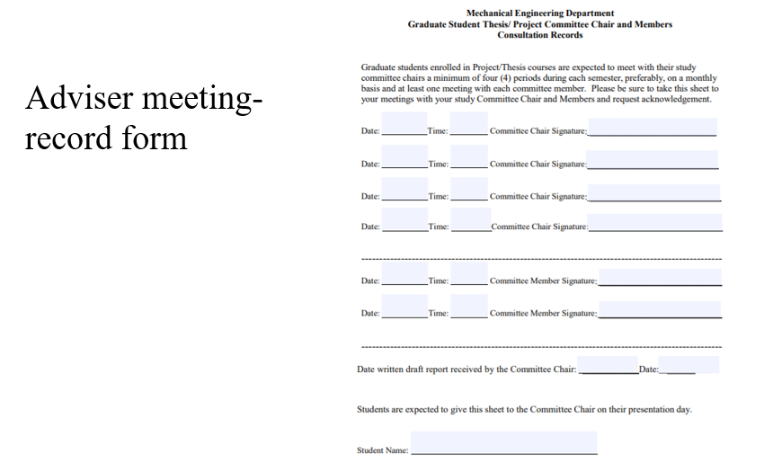

Slide 11

5. Oral Presentation
NOTE: This is scheduled by the ME office

Slide 12
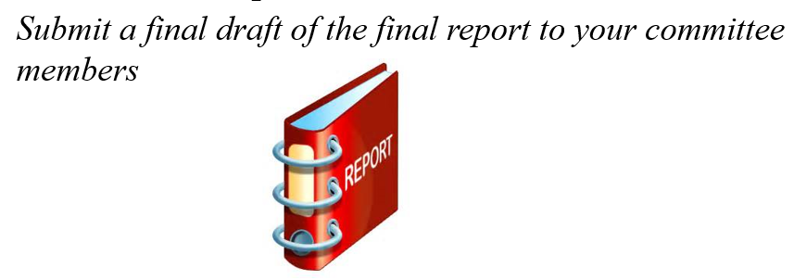
5. Oral Presentation
Before the Oral presentation:

Slide 13
Deliverables
1. Midterm Report: Check with your committee chair
2. Oral Presentation
3. Final Report (draft): Before you make the Oral
presentation
4. Advisory committee consultation form
4. Final Report: For due date, check with your Committee Chair

Slide 14

How to Arrange for the Oral Presentation?
Contact the ME office to schedule your oral presentation. The ME office will contact your advisory committee and schedule your presentation.

Slide 15
How to Add ME 295 A or ME 299
You must have an approved proposal to get an add code.
After the proposal is fully approved, you can get the add code from the ME office.
No Pre-registration allowed

Slide 16
Important dates and Deadlines
This Semester:
May 1, 2026
    Project Initiation Meeting
May 1, 2026, through May 20, 2026
    1. Search for Possible Projects
    2. Contact ME Professors and select a Committee Chair
    3. Form the advisory committee
    4. Conduct a literature search on the project-topic and prepare a draft of the project proposal.

Slide 17
Important dates and Deadlines
Next Semester
August 20, 2026, through September 8, 2026:
    Finalize the draft of the project proposal
    Have the proposal approved by the advisory committee
    Be ready to submit the proposal to the department office
September 8, 2026: Submit the approved proposal to the ME office, for review and approval by the Graduate Advisor and the department Chair
September 15, 2026: Last Day to Add Courses

Slide 18
Note
When your proposal is approved by the ME office, you can obtain the add code from the office.

Slide 19
Available Projects

Slide 20
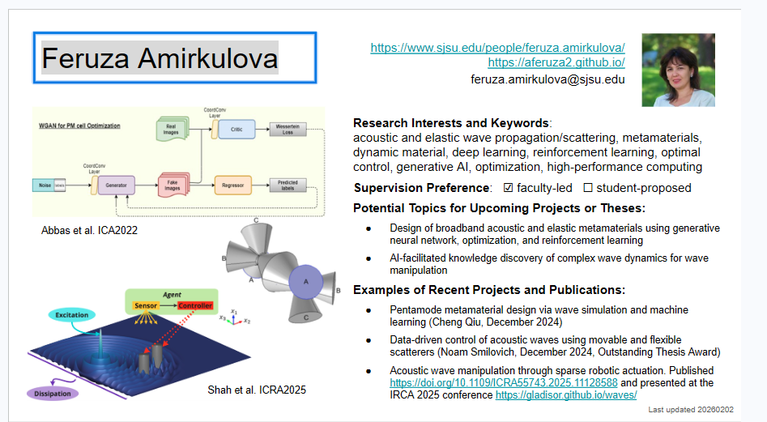
Feruza Amirkulova

Slide 21
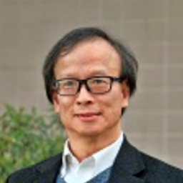
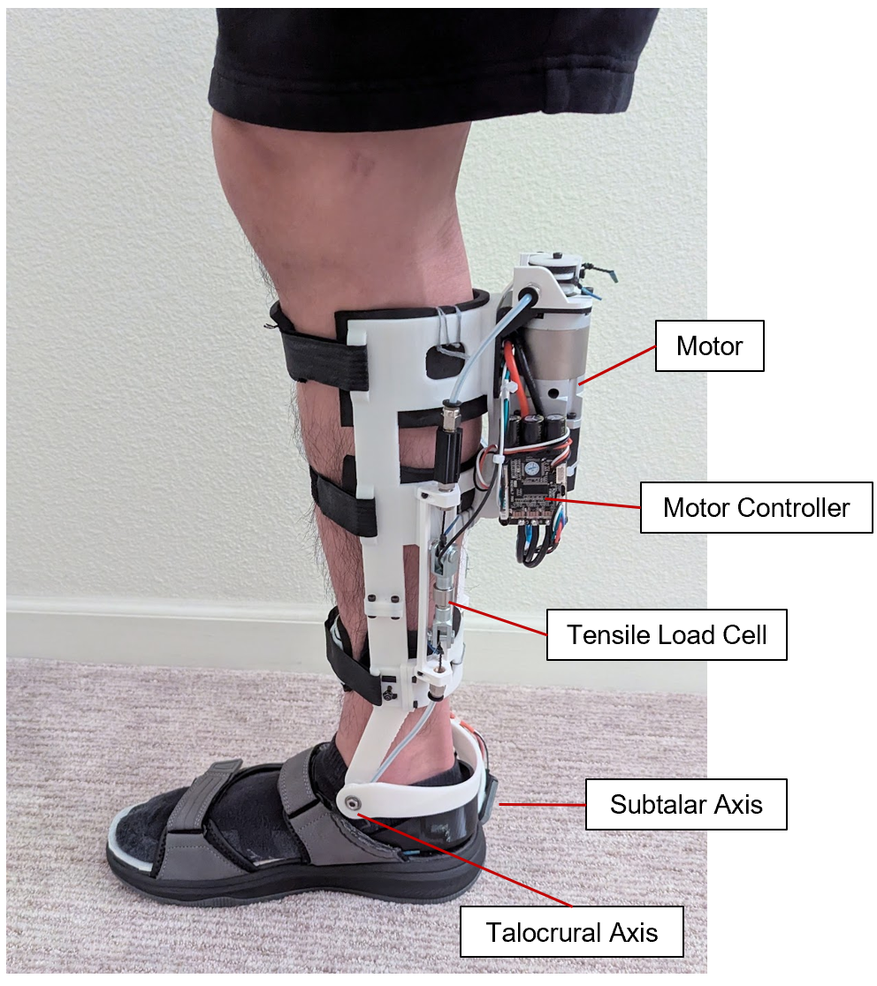
Raymond K. Yee
https://www.sjsu.edu/people/raymond.yee/
https://www.linkedin.com/in/raymond-k-yee-54b58a36/
raymond.yee@sjsu.edu
Research Interests and Keywords:
mechanical design, biomechanics, assistive mobility device, healthcare engineering, control system
Supervision Preference: ☑ faculty-led ☐ student-proposed
Potential Topics for Upcoming Projects or Theses:
Powered Ankle-Foot Orthosis
Objective: To improve the current prototype design and develop an assistive mobility device that improves gait stability in the aging population, with the goal of reducing fall risk.
Area of Improvement: 1) Further development of the control system to improve device responsiveness and adaptability to user-specific gait patterns. 2) Prototype structure robustness
The powered ankle-foot orthosis enhances frontal plane ankle torque generation to target mediolateral stability during gait. The device aims to reduce fall-related injuries and promote greater independence in older adults.
Prototype device of current research
Last updated 20260501

Slide 22


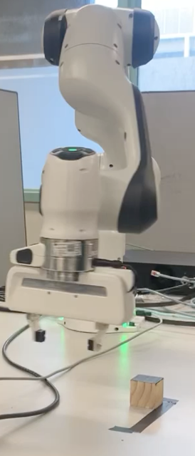
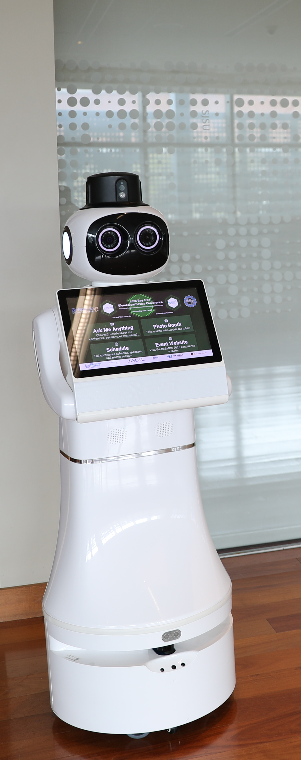
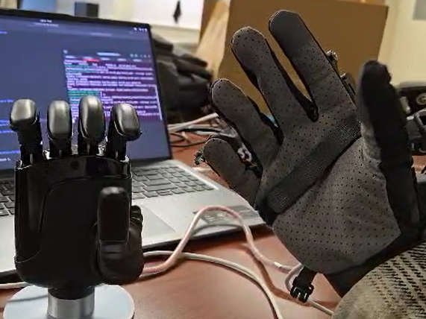
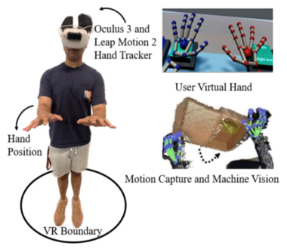
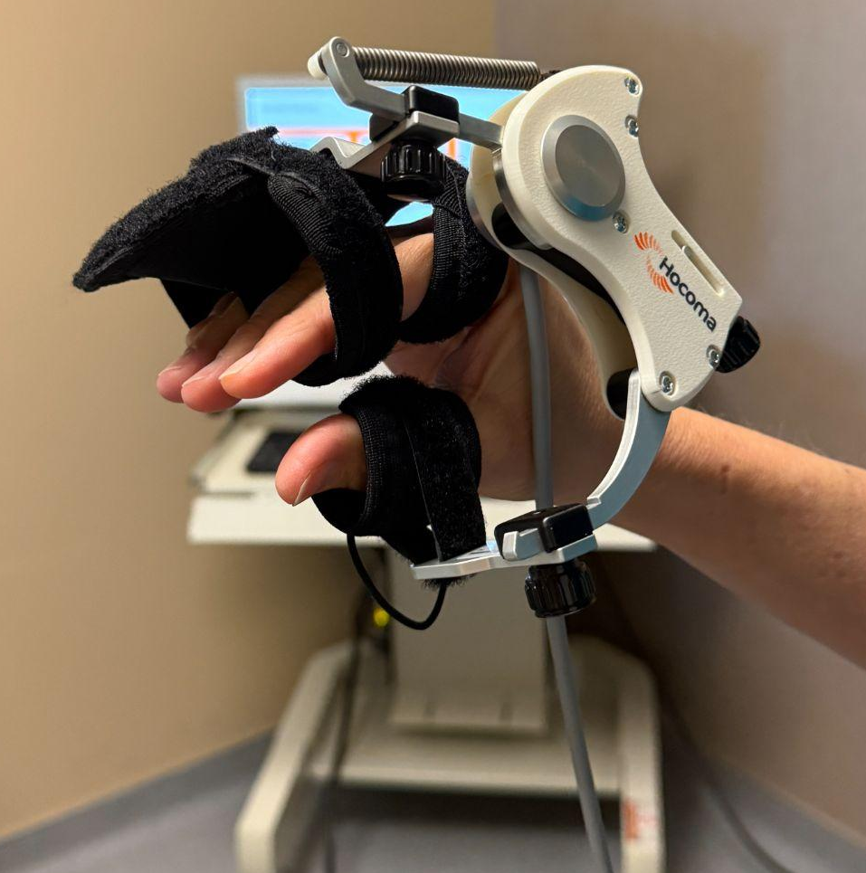
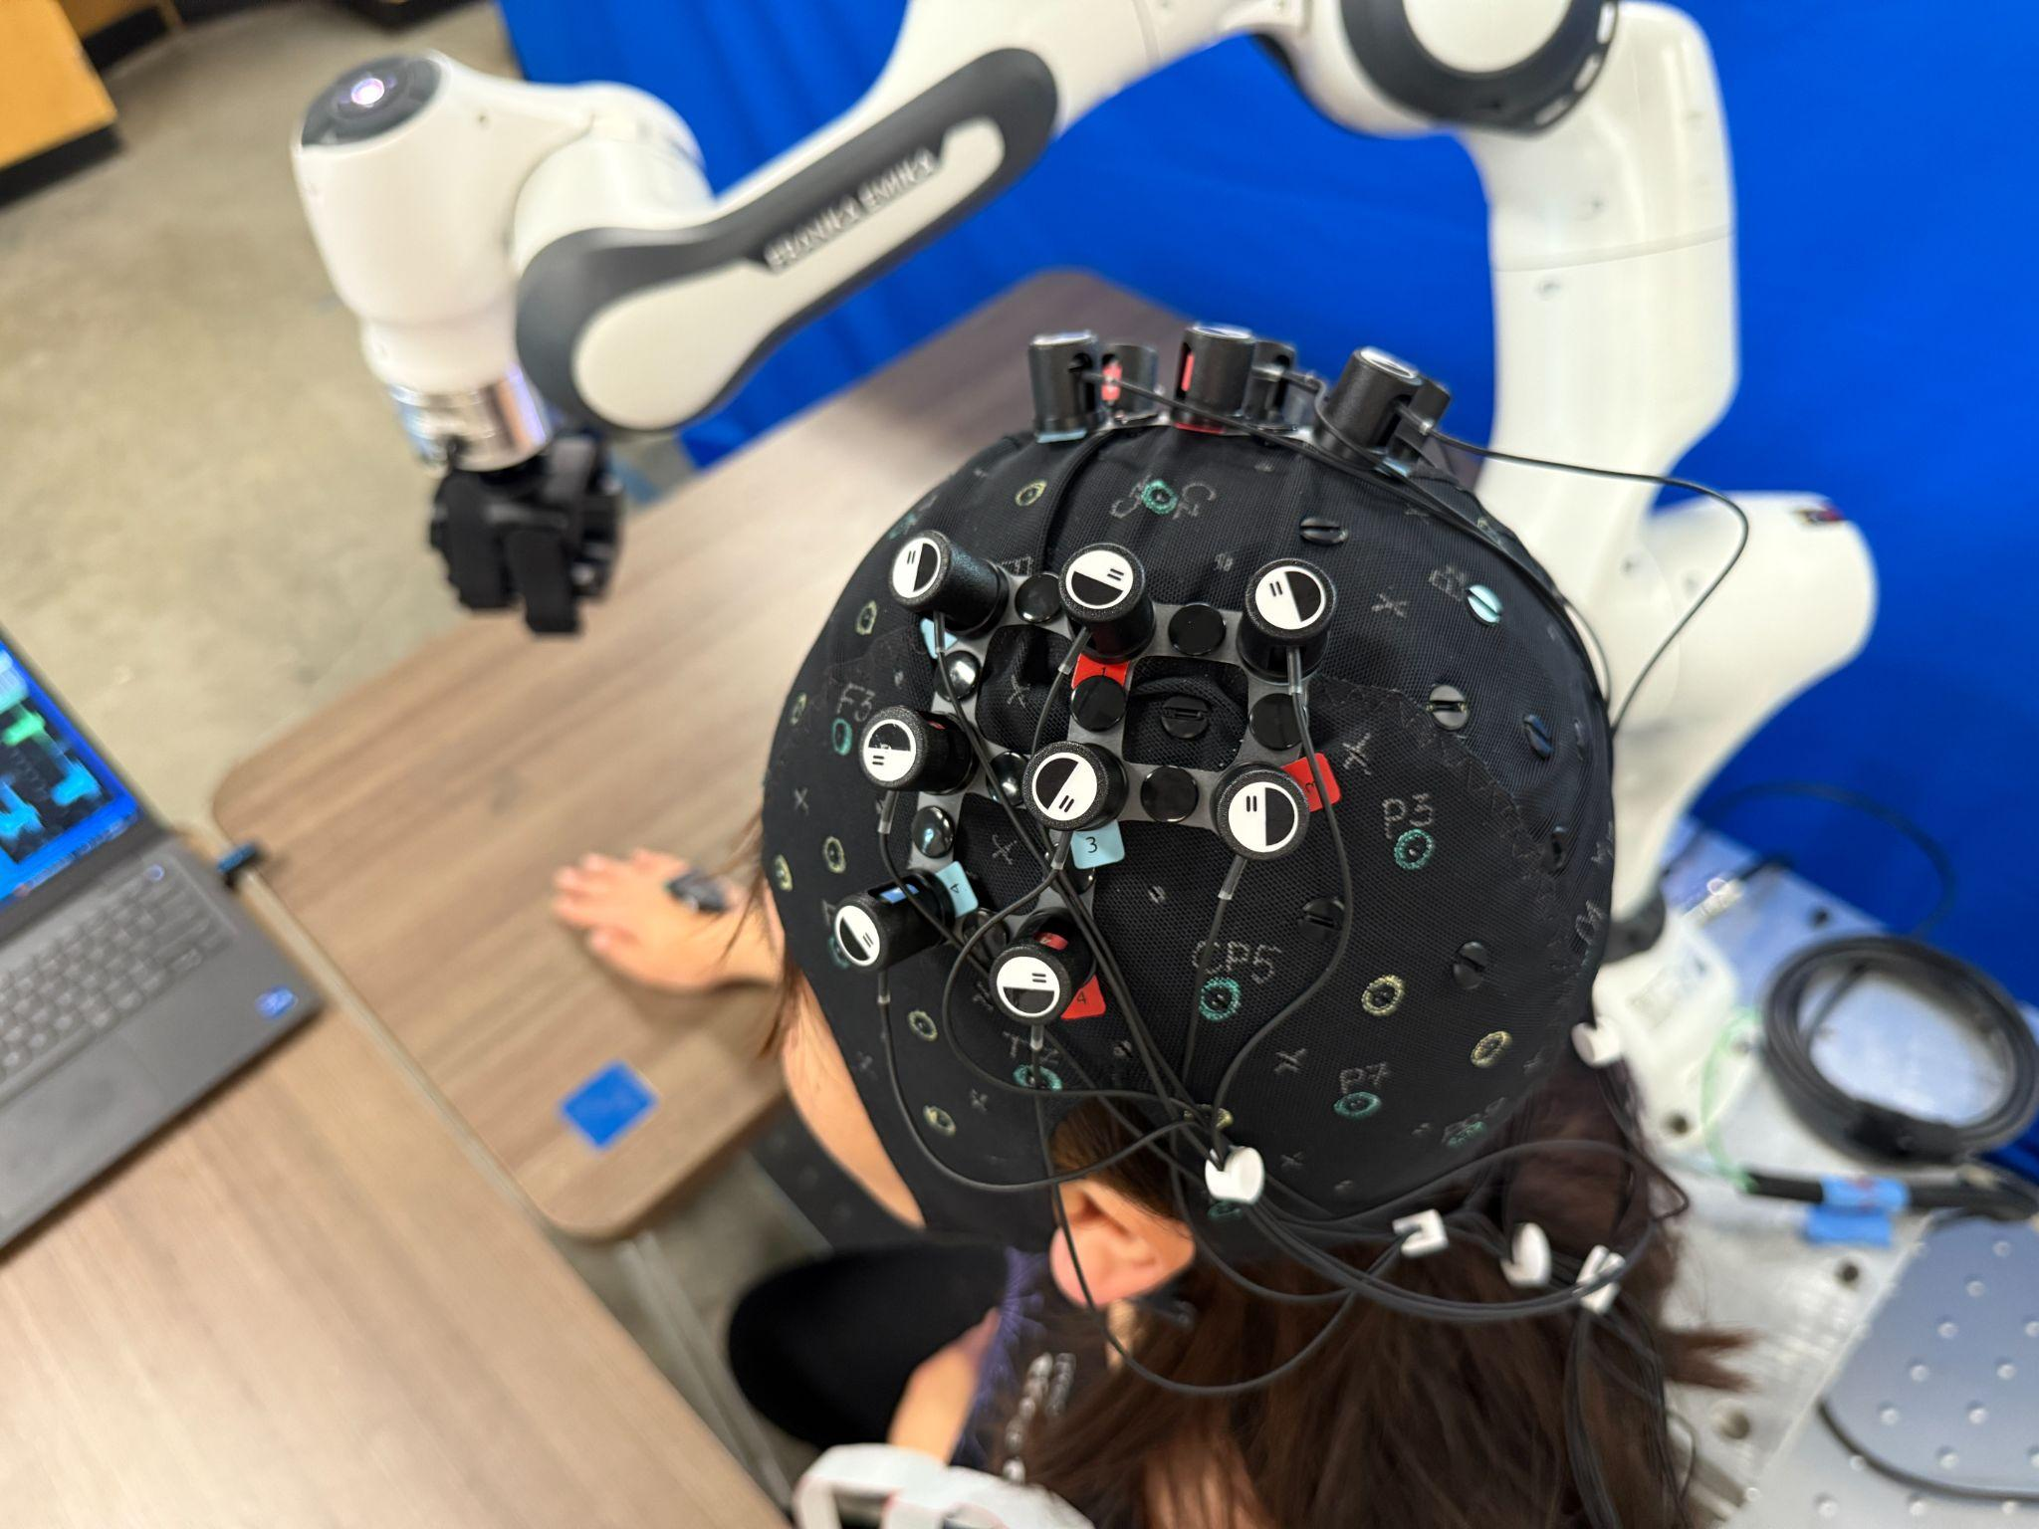
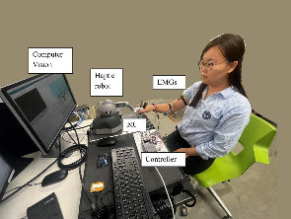
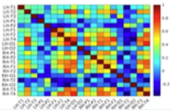
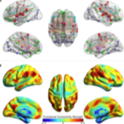

Lin Jiang
https://www.sjsu.edu/people/lin.jiang/
https://sites.google.com/sjsu.edu/biorob/
https://orcid.org/0000-0003-3085-9847
lin.jiang@sjsu.edu
Research Interests and Keywords:
Embodied/physical AI, human-robot interactions, multimodal perception (vision–proprioception–force); sensorimotor learning; sim-to-real transfer; robotic therapy; human machine interface
Supervision Preference: ☑ faculty-led ☑ student-proposed
Potential Topics for Upcoming Projects or Theses:
Model-based reinforcement learning for sim-to-real transfer
Latent-space VLA motion planning for efficient navigation in high dimensional robot
Unified embodied policy for navigation and dexterous manipulation
Neuroadaptive robotic hand therapy with fNIRS-derived intent and engagement metrics
Evaluation of brain oxygenation and function in newborns with and without brain injury using bedside non-invasive monitoring (fNIRS)
Examples of Related Publications:
Reiner et al., IISE Trans. Occup. Ergon. Hum. Factors, 2026 [DOI:10.54941/ahfe1006382]
Allawi et al., ASME J. Med. Diagn., 2026 [https://doi.org/10.1115/1.4071027]
Benzo et al., ASME J. Med. Diagn., 2024 [https://doi.org/10.1115/1.4067182]
Li et al., Biomimetics, 2023 [https://doi.org/10.3390/biomimetics8020190]
Jiang et al., TBME, 2021.
Jiang et al., IEEE RAL, 2022.
Jiang et al., J. Biomech.Eng. 2020
Jiang et al., Exp. Fluids. 2020
a) Franka Robot for learning, Service and companion robot, Humanoid Robot hand in the lab. VR/AR robot teleoperation and Imitation learning for human-in-the-loop robot control, supported by NSF CISE Award # 2431636
b) Robotic hand therapy solution: AMREO robotic hand for occupational therapy treatment at SVMC, and neurorehabilitation platform at SJSU
Brain functional connectivity
Brain Activity mapping
c) Neurodevelopment study for premature infants, collaborate with SCVMC
Last updated 20260428

Slide 23

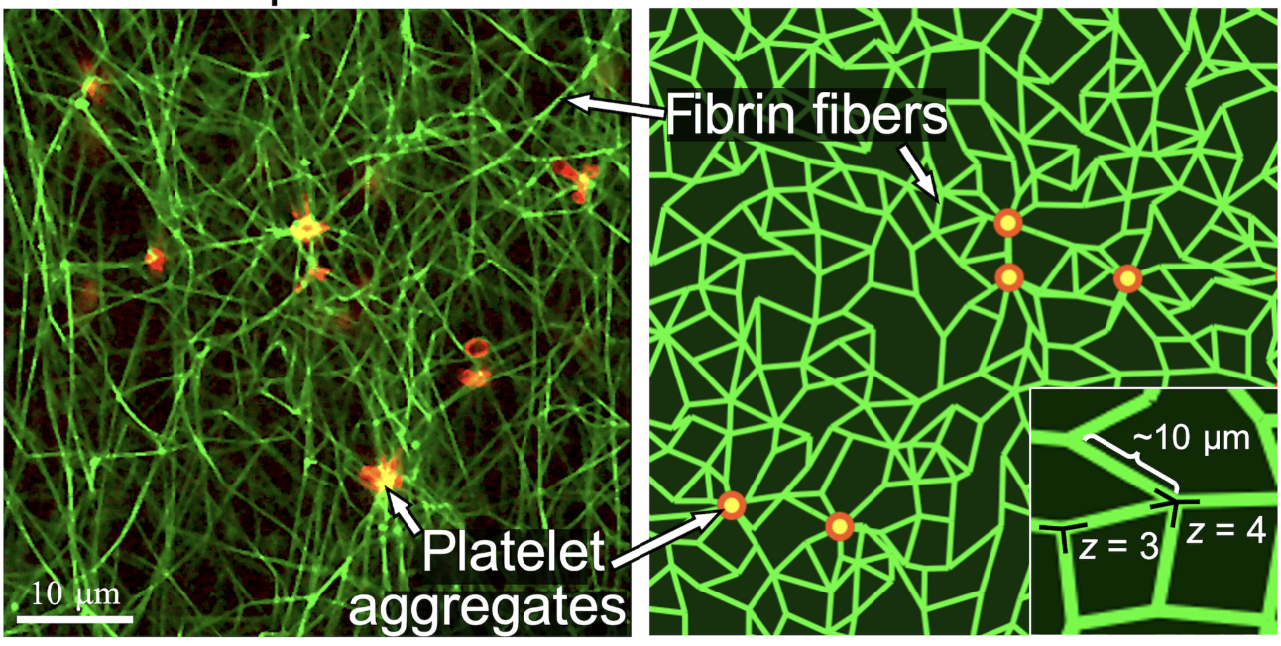
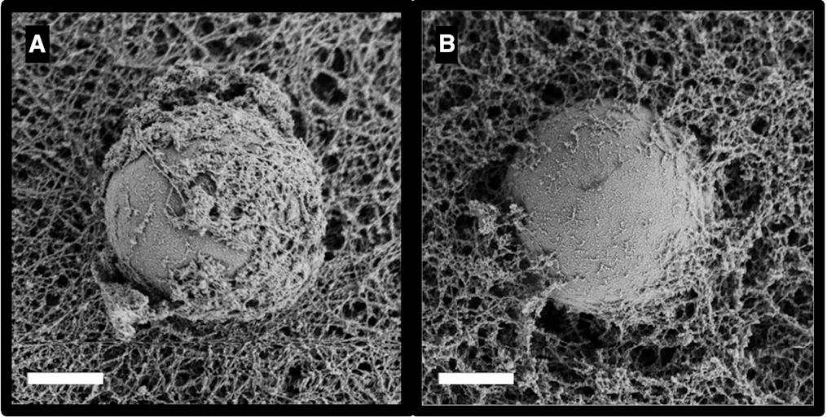
Sang-Joon (John) Lee
https://www.sjsu.edu/people/sang-joon.lee/
https://www.sjsu.edu/mems/
https://orcid.org/0000-0003-4522-0560
sang-joon.lee@sjsu.edu
Research Interests and Keywords:
microfluidics, tissue mechanics, hemodynamics, microfabrication, microelectromechanical systems (MEMS)
Supervision Preference: ☑ faculty-led ☐ student-proposed
Potential Topics for Upcoming Theses:
Magnetic bead microrheology for probing localized mechanics in active biopolymer networks
Microfluidic interrogation of red blood cell deformability (part of NIH 1R15HL177762-01)
Process engineering and nanomechanical characterization of thin-film electrolytes for solid-state lithium batteries
Examples of Recent MSME Theses:
Effects of microgravity on the dynamic response of a closed-loop perfusion system (A. Schweizer, Fall 2025)
Multiphysics simulation of polymer-ceramic composite electrolytes under compression (M. Suski, Spring 2026)
Platelets in fibrin network and model thereof, from https://doi.org/10.1101/2023.03.24.534185
2 µm
Microbeads with differing "grip" in fibrin, from https://doi.org/10.1016/j.bpr.2025.100207
Last updated 20260128

Slide 24
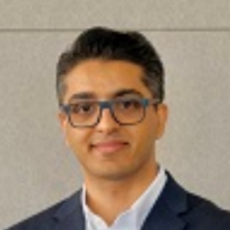
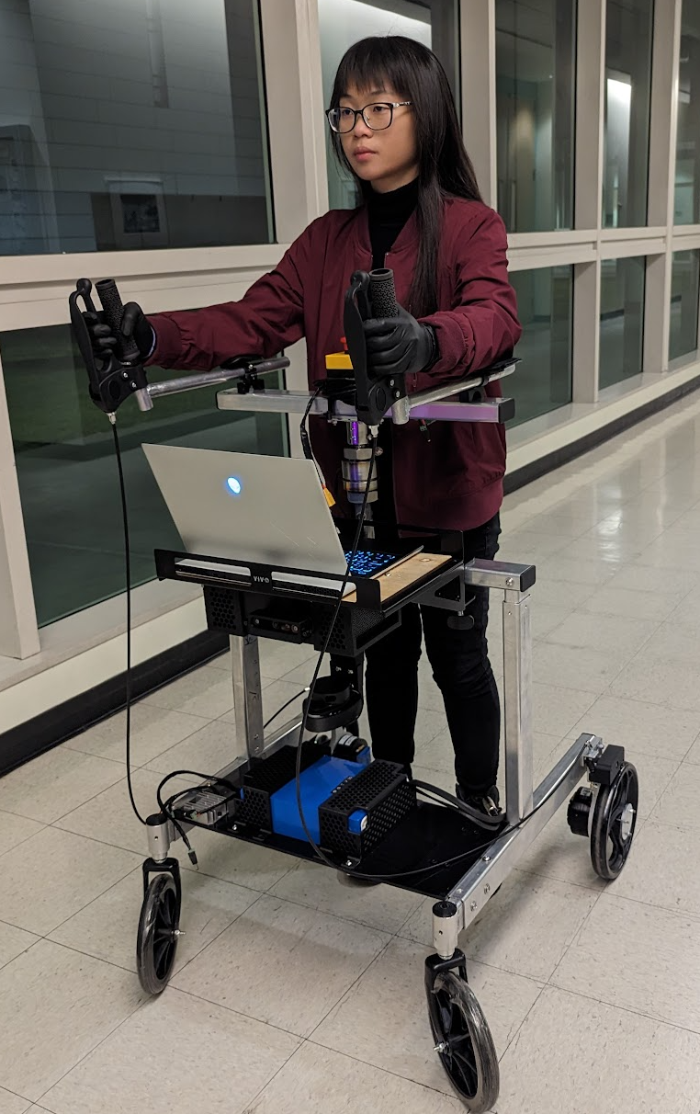
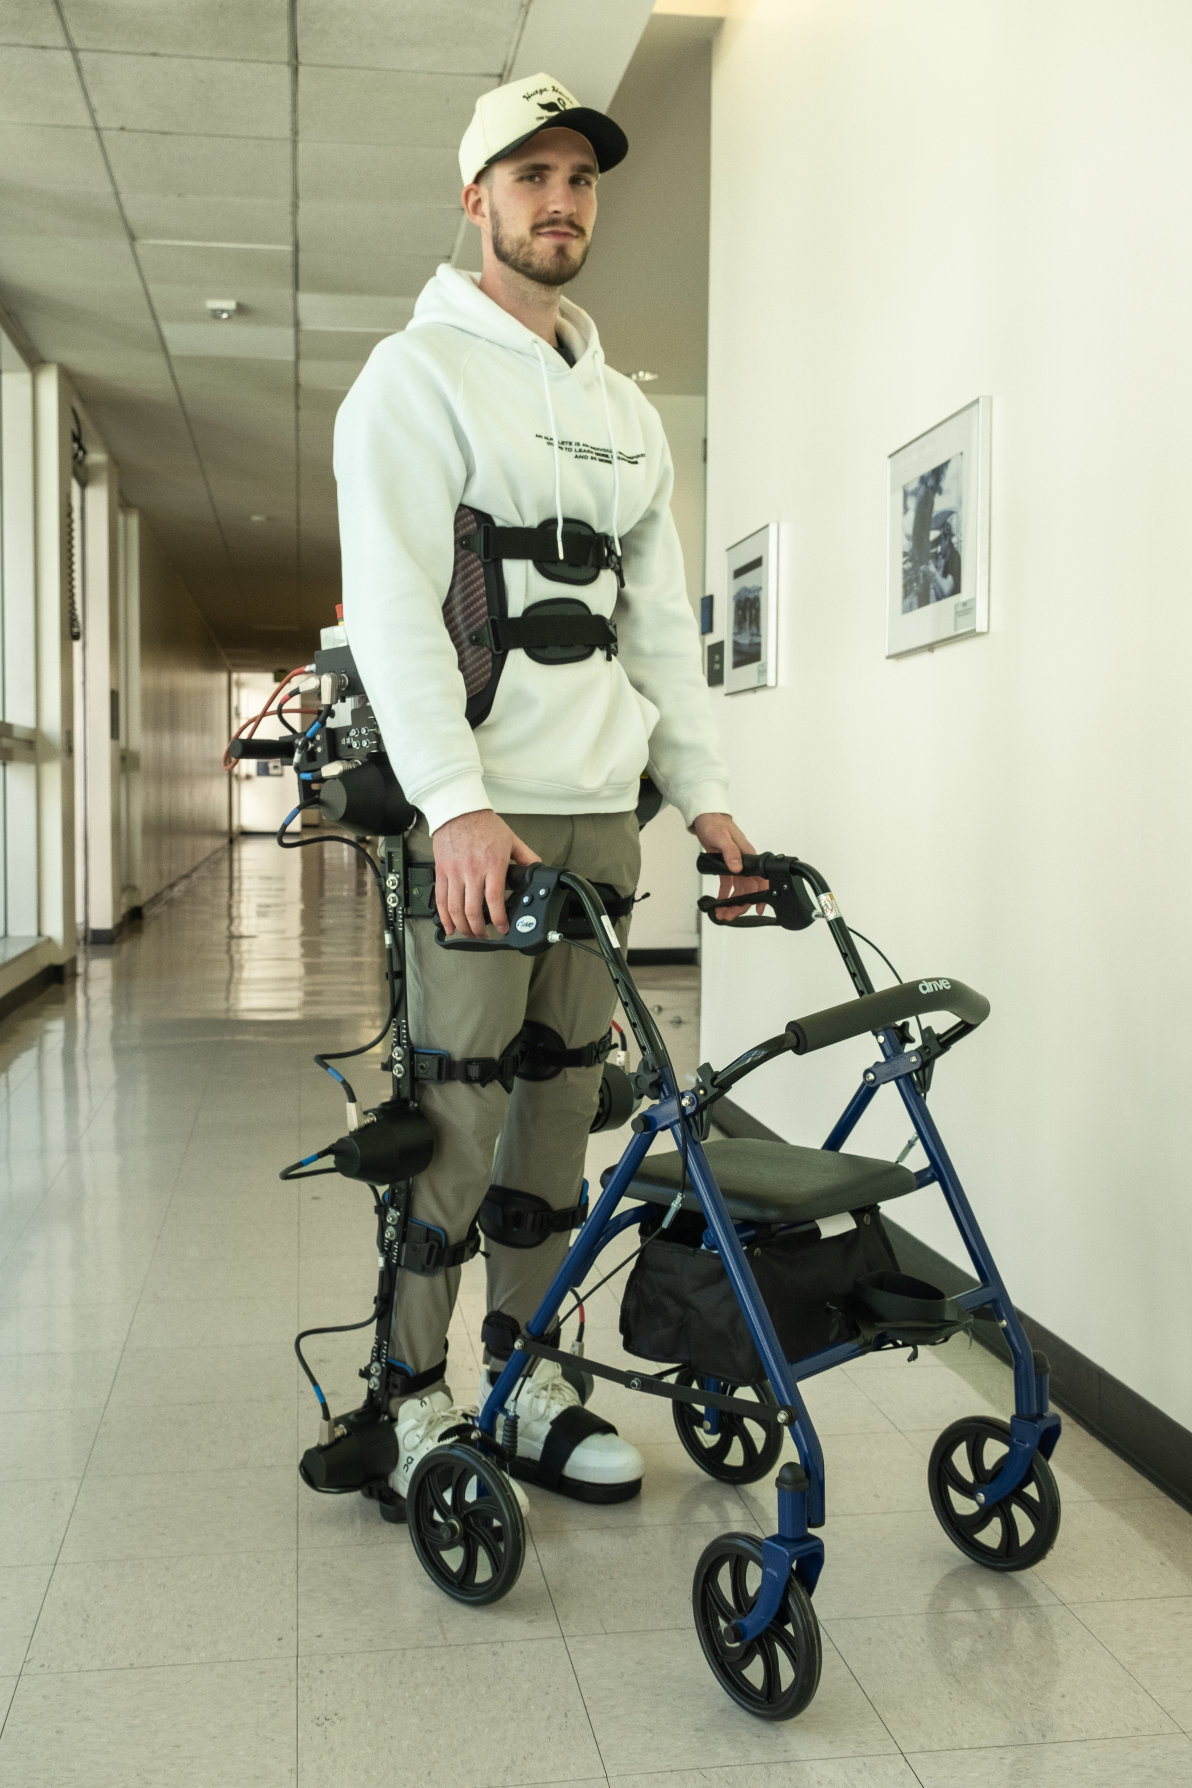
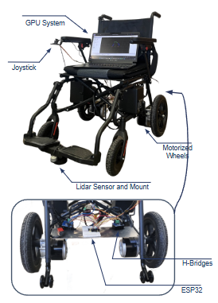
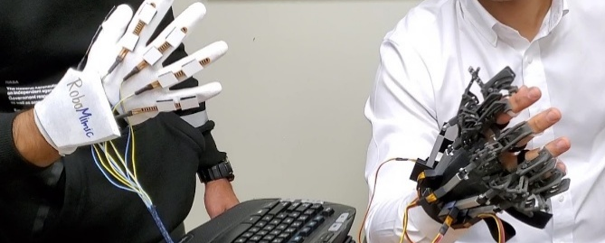
Mojtaba Sharifi
https://scholar.google.com/citations?user=uoQP2HwAAAAJ
https://sites.google.com/sjsu.edu/armslab
mojtaba.sharifi@sjsu.edu
(a) (b) (c)
(d)
(a) Smart walker, (b) lower limb exoskeleton (Exo-H3), (c) autonomous wheelchair, and (d) hand exoskeleton, for assisting people with disabilities
Research Interests and Keywords:
medical and assistive robotics, human-robot interaction, biomedical engineering, mechatronic systems, intelligent control, machine learning
Supervision Preference: ☑ faculty-led ☐ student-proposed
Potential Topics for Upcoming Projects or Theses:
Control and AI for a smart robotic walker, for people with dementia (funded by CSU grant)
Intelligent control of lower-limb exoskeleton with machine learning tools for personalized and stable walking (funded by NSF grant)
Mechatronics, control, and AI for a sensorized and motorized wheelchair with obstacle avoidance
Bilateral control of a hand exoskeleton with position and force feedback for remote rehabilitation
Last updated 20260128

Slide 25
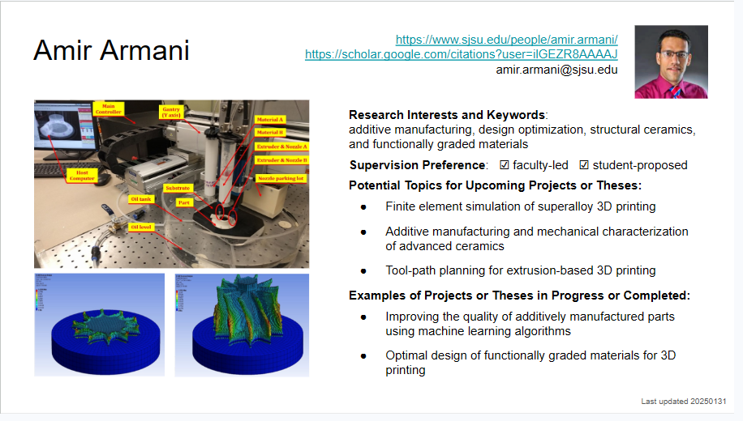

Slide 26
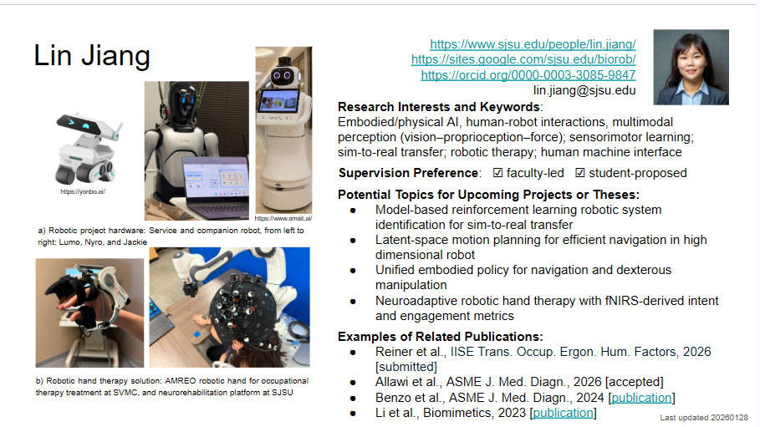

Slide 27
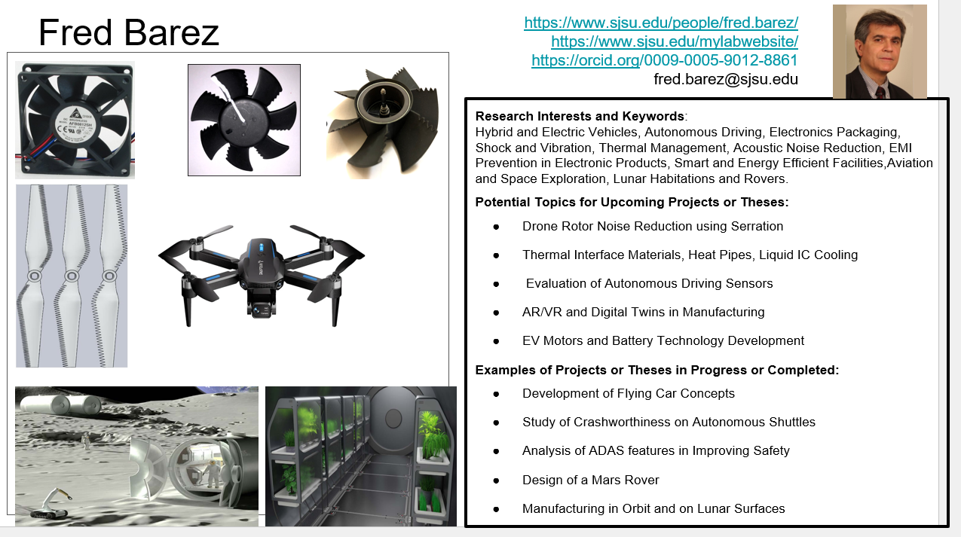

Slide 28
